Slide 1

Shadow-Bitcoin: Scalable Simulation via Direct Execution of Multi-threaded Applications
Workshop on Cyber Security Experimentation and Test
August 10th, 2015
Andrew Miller, University of Maryland
amiller@cs.umd.edu
Rob Jansen, U.S. Naval Research Laboratory
rob.g.jansen@nrl.navy.mil

Slide 2
[video removed for space reasons]

Slide 3
Goals of this Work
Directly execute Bitcoin inside the Shadow network simulator
Run a local and private Bitcoin network
Explore performance attacks on Bitcoin using our simulation framework

Slide 4
Why should anyone care?
Expedite research and development
Evaluate software mods or attacks without harming real users
Understand holistic effects before deployment
Our techniques allow simulation support for many new applications and domains

Slide 5
Shadow Background
Thread 1

Slide 6

What is Shadow?
Parallel discrete-event network simulator
Emulates POSIX C API on Linux, directly executes apps as plug-ins
Simulates time, network, CPU
Models routing, latency, bandwidth

Slide 7
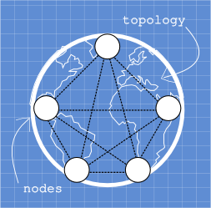
Bootstrapping Shadow
Notes:
Blueprint contains network structure and bootstraps the simulation
Nodes are created, each runs a given plugin application
Manage nodes with memory swapping
Intercept network functions which queues new events

Slide 8
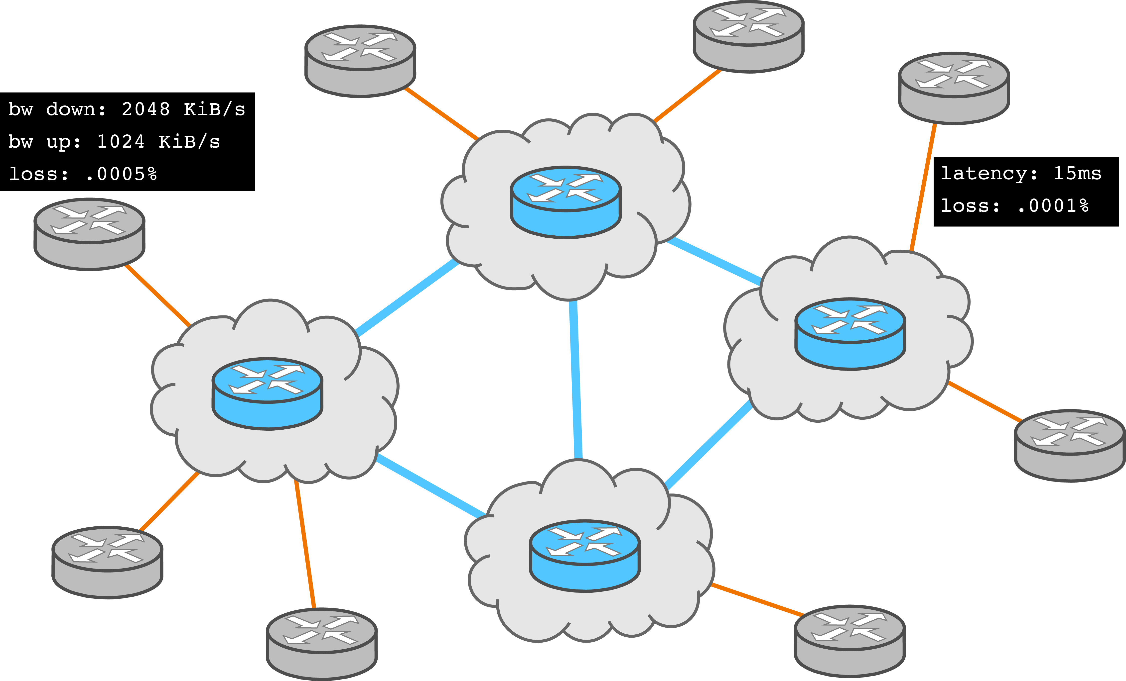
Virtual Network Configuration

Slide 9

Virtual Host Configuration

Slide 10


Simulation Engine
Main event queue
Worker threads
Virtual hosts
Virtual processes

Slide 11
Simulation Engine
Compile with Clang, extract state addresses with LLVM pass
Addr | Val
0xA | 0
0xB | 0
… | …
Each program loaded only once per thread

Slide 12
Simulation Engine
Addr | Val
0xA | 0
0xB | 0
… | …
Save default values on initial load
Copy state for each virtual process
Addr | Val
0xA | 15
0xB | 87
… | …
Addr | Val
0xA | 22
0xB | 62
… | …
Addr | Val
0xA | 33
0xB | 85
… | …
Addr | Val
0xA | 5
0xB | 59
… | …

Slide 13
Simulation Engine
Addr | Val
0xA | 0
0xB | 0
… | …
Swap state into/out of memory as virtual processes are switched
Addr | Val
0xA | 15
0xB | 87
… | …
Addr | Val
0xA | 22
0xB | 62
… | …
Addr | Val
0xA | 33
0xB | 85
… | …
Addr | Val
0xA | 5
0xB | 59
… | …

Slide 14
Function Interposition
LD_PRELOAD=/home/rob/libpreload.so
libpreload (socket, write, …)
Shadow Engine
App
Plug-in
App Libraries
(libc, …)

Slide 15
Function Interposition
LD_PRELOAD=/home/rob/libpreload.so
libpreload (socket, write, …)
Shadow Engine
App
Plug-in
App Libraries
(libc, …)
hooks

Slide 16
Function Interposition
LD_PRELOAD=/home/rob/libpreload.so
libpreload (socket, write, …)
Shadow Engine
App
Plug-in
App Libraries
(libc, …)
hooks
fopen

Slide 17
Function Interposition
LD_PRELOAD=/home/rob/libpreload.so
libpreload (socket, write, …)
socket
Shadow Engine
App
Plug-in
App Libraries
(libc, …)
hooks
fopen

Slide 18
Function Interposition
LD_PRELOAD=/home/rob/libpreload.so
libpreload (socket, write, …)
write
Shadow Engine
App
Plug-in
App Libraries
(libc, …)
hooks
fopen

Slide 19
Function Interposition
LD_PRELOAD=/home/rob/libpreload.so
libpreload (socket, write, …)
Single call stack, must return
write
Shadow Engine
App
Plug-in
App Libraries
(libc, …)
hooks
fopen

Slide 20
Shadow limitations
App shall not block
Call any blocking library function (sleep)
Use blocking descriptors (read/write, send/recv)
Wait for events (select, poll)
Busy wait (infinite loop)

Slide 21
Shadow limitations
App shall not block
Call any blocking library function (sleep)
Use blocking descriptors (read/write, send/recv)
Wait for events (select, poll)
Busy wait (infinite loop)
App shall not spawn
Multiple threads (pthreads)
Multiple processes (fork, exec)

Slide 22
Shadow limitations
App shall not block
Call any blocking library function (sleep)
Use blocking descriptors (read/write, send/recv)
Wait for events (select, poll)
Busy wait (infinite loop)
App shall not spawn
Multiple threads (pthreads)
Multiple processes (fork, exec)
Problems! Bitcoin blocks and spawns threads! ☹

Slide 23
Running Bitcoin in Shadow
Thread 2

Slide 24
Architectural Update
Virtual processes
New virtual thread layer

Slide 25
Non-blocking Virtual Threads
GNU portable threads (pth) to the rescue
User-land cooperative threading (non-preemptive)
Single OS thread, multiple portable threads, supports pthread API
Supports many blocking IO functions: uses make/set/get/swapcontext() magic to jump program stacks

Slide 26
Limitations of GNU pth
Not reentrant or thread-safe
Relies on select() to poll events when all portable threads would block (max 1024 fds)

Slide 27
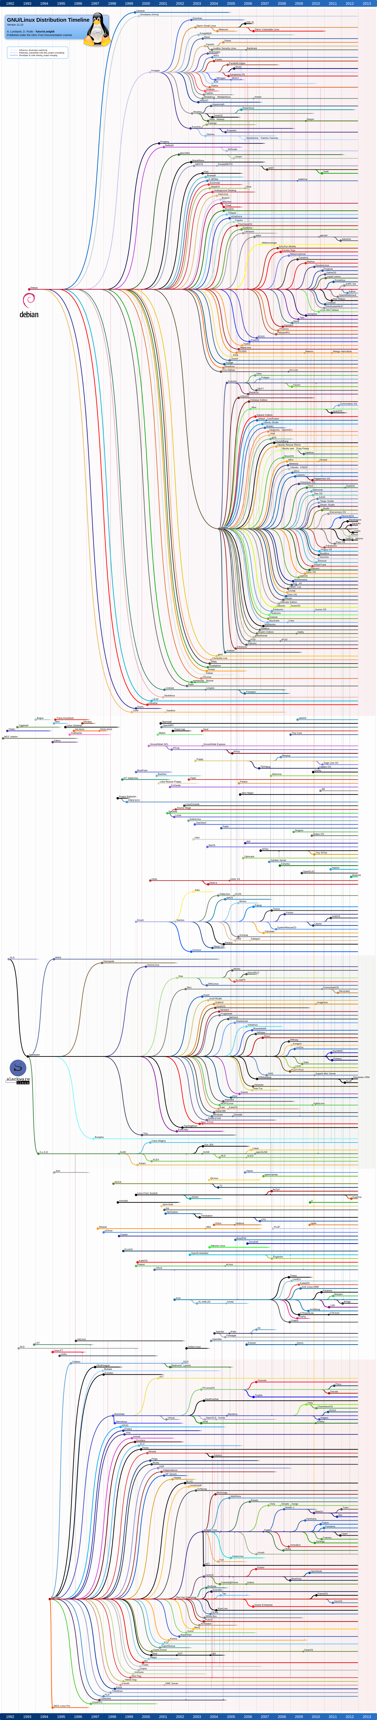
If you don’t like it, fork it

Slide 28
Reentrant Portable Threads (rpth)
Not reentrant or thread-safe
Relies on select() to poll events when all portable threads would block (max 1024 fds)

Slide 29
Reentrant Portable Threads (rpth)
Not reentrant or thread-safe
Replace global state with user-supplied states
Thread-local storage for current state pointer
Relies on select() to poll events when all portable threads would block (max 1024 fds)

Slide 30
Reentrant Portable Threads (rpth)
Not reentrant or thread-safe
Replace global state with user-supplied states
Thread-local storage for current state pointer
Relies on select() to poll events when all portable threads would block (max 1024 fds)
Replace blocking select with asynchronous epoll
Add API support for epoll and timers

Slide 31
Integrating rpth with Shadow
Each virtual process has a private rpth instance
Shadow thread

Slide 32
Integrating rpth with Shadow
Spawns an rpth thread to call the program main() function
Shadow thread
“main” thread

Slide 33
Integrating rpth with Shadow
Program may spawn auxiliary threads
Shadow thread
“main” thread
spawned threads

Slide 34
Execution Flow with rpth
Return to Shadow thread when all spawned rpth threads would block:
Swap in virtual process and rpth state
Swap out virtual process and rpth state
rpth scheduler
Time

Slide 35
Creating a Private Bitcoin Network
Crawled Bitcoin with CoinScope to learn topology – 6081 nodes (40% US, 40% EU)
Geo-locate nodes based on IP address
Bootstrap blockchain – Bitcoin block and index files are COW – enables aliasing of these large state files
Inject new transactions to each node to simulate spending

Slide 36
Transaction Propagation
Faster
Slower

Slide 37
Simulation Resource Usage
For each node: ~2.1 seconds to run 120 ticks
(~57x speedup)
For each node: ~51.2 MiB consumed

Slide 38
Attacking Bitcoin
Thread 3

Slide 39
Transaction Handling
Transactions form a directed graph
Tx with parent gets handled immediately
Validate Tx, verify up to 40 sigs
Senders of invalid Txs are marked as bad, and eventually disconnected

Slide 40
Transaction Handling
Transactions form a directed graph
Tx with parent gets handled immediately
Validate Tx, verify up to 40 sigs
Senders of invalid Txs are marked as bad, and eventually disconnected
What if Tx has no parent?
Tx w/o parent gets queued as orphan
Once queued, sender of orphan is forgotten
When new Tx arrives, all linked orphans are validated (40 sig verifications each)

Slide 41
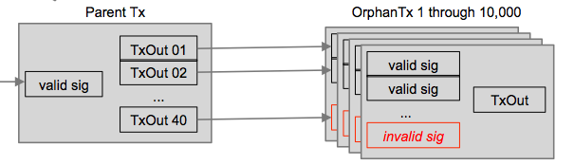
Dos Attack
Goal: Freeze a victim node
Fill up orphans queue with invalid Txs
Send valid parents with outputs linked to orphans
Node checks all orphans

Slide 42
Dos Attack
Goal: Freeze a victim node
Fill up orphans queue with invalid Txs
Send valid parents with outputs linked to orphans
Node checks all orphans
40 sigs/orphan, 10k orphans max,
0.6ms per sig
Freeze for 4+ mins, Peers will abort,
No one to blame

Slide 43
RAM Consumption
While MessageHandler thread is frozen, SocketHandler thread buffers peer data
Disconnect peer if |recvBuf| > 5 MiB

Slide 44
RAM Consumption
While MessageHandler thread is frozen, SocketHandler thread buffers peer data
Disconnect peer if |recvBuf| > 5 MiB
Attack
Establish 100+ connections to victim
While victim is frozen, fill recvBuf to max
Can crash node if < 500 MiB available

Slide 45
Attack Time and Cost Profile

Slide 46
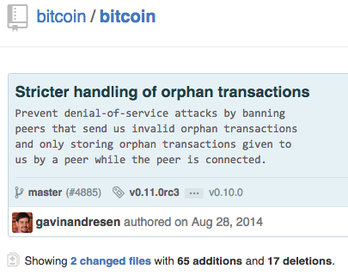
Fix Applied to Bitcoin
Fixed in commit 0608780

Slide 47

Summary/Conclusion
Enhanced Shadow to support applications that block and use multiple threads
Wrote new Bitcoin plug-in for Shadow
Created Bitcoin network for simulation
Found and fixed orphans attack using new simulator architecture
shadow.github.io
github.com/shadow
robgjansen.com, @robgjansen
rob.g.jansen@nrl.navy.mil
think like an adversary

